Slide 1
Bethel Tech Christmas Challenge
Hans-Jörg Stark
December 2021

Slide 2
Task
Two questions to answer
What can you tell me about week position?
What can you tell me about weeks on the chart?

Slide 3
General Information on the data
The dataset contains information on Christmas-songs on the chart from the 1950ies until the 2010s
A unique entry is the combination of song-title and performer
Individual songs can appear more than once because they were performed by different performers
Individual performers can appear more than once because they can perform different songs in different seasons

Slide 4
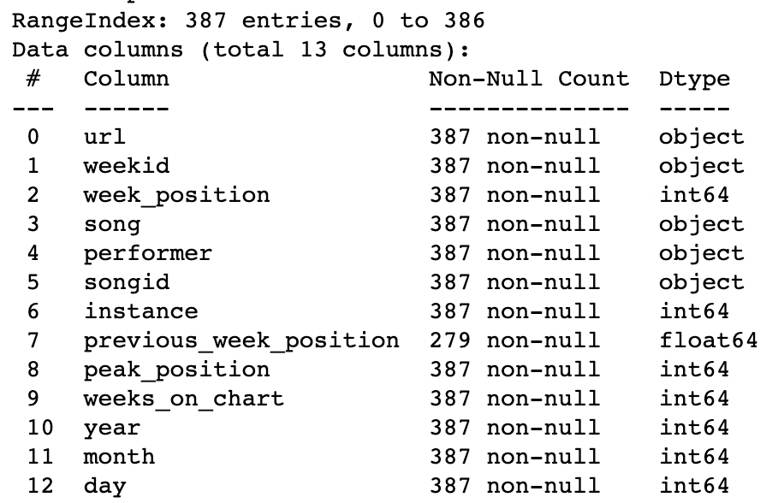
General Information on the data
387 entries / records
13 attributes
70 unique songs
69 unique performers
78 unique combinations of performer & song

Slide 5
General Information on the data
Some data-wrangling was done in MS Excel: I added a column that indicates whether the performer is an individual or a group
Thereafter, I added some more variables to the dataset that were derived from the information given, like:
first position of a song before or after Christmas
Number of days to Christmas of a record
Does the title contain “Christmas”
etc. (cf. Jupyter Notebook)

Slide 6
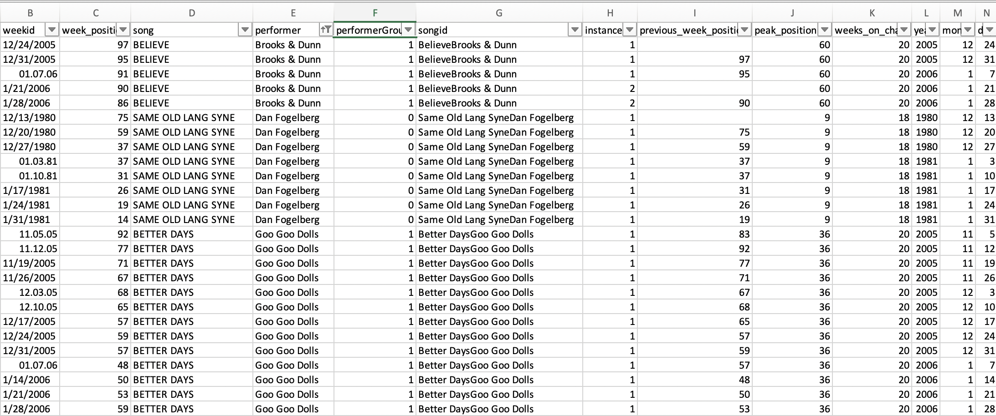
General Information on the data
Data Problem I: The peak-position does not match with the minimal week-position for 3 songs:
Due to lack of knowledge on the data and their origin no action was taken

Slide 7
General Information on the data
Data Problem II:
There is a problem that some data is only available on song-ID level. For instance, the peak-position is the same for one song no matter whether it was more than once or just once on the charts (instance =1 or instance > 1). The same is true of the number of weeks on the chart: It is an overall sum, not a sum of the number of weeks on chart for one season. This makes it difficult to compare the data is some ways.
This is illustrated on the next slide.
The number of weeks on the chart per season for every song were computed and used this information to test whether a machine learning approach would be able to predict the time of presence of a song on the chart (at the very end of this presentation and the Jupyter Notebook).

Slide 8
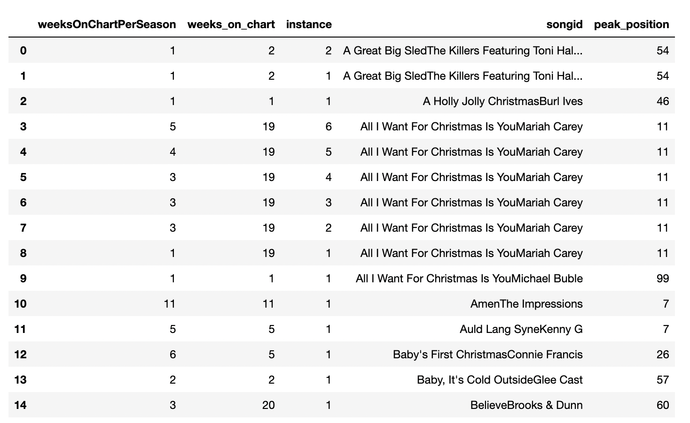
General Information on the data

Slide 9
What can you tell me about week position?
The average initial position of a song is 75.3
The overall average position of a song is 57.2
→ This means that on average the initial position of a song is worse or higher than the overall average position of all songs during their presence in the charts. In other words, a song on average improves its position.

Slide 10
What can you tell me about week position?
The median initial position of a song is 82.
The overall median position of a song is 58.
→ This confirms the findings based on average analysis: The initial position of a song is worse than the overall weekly position of all songs at all times.

Slide 11
What can you tell me about week position?
General statistical information on week position:
Count: 387.000000
Mean: 57.204134
Stand Dev: 25.398527
Min: 7.000000 = best position
25%: 38.500000
50%: 58.000000 = median position
75%: 78.000000
Max: 100.000000 = worst position

Slide 12
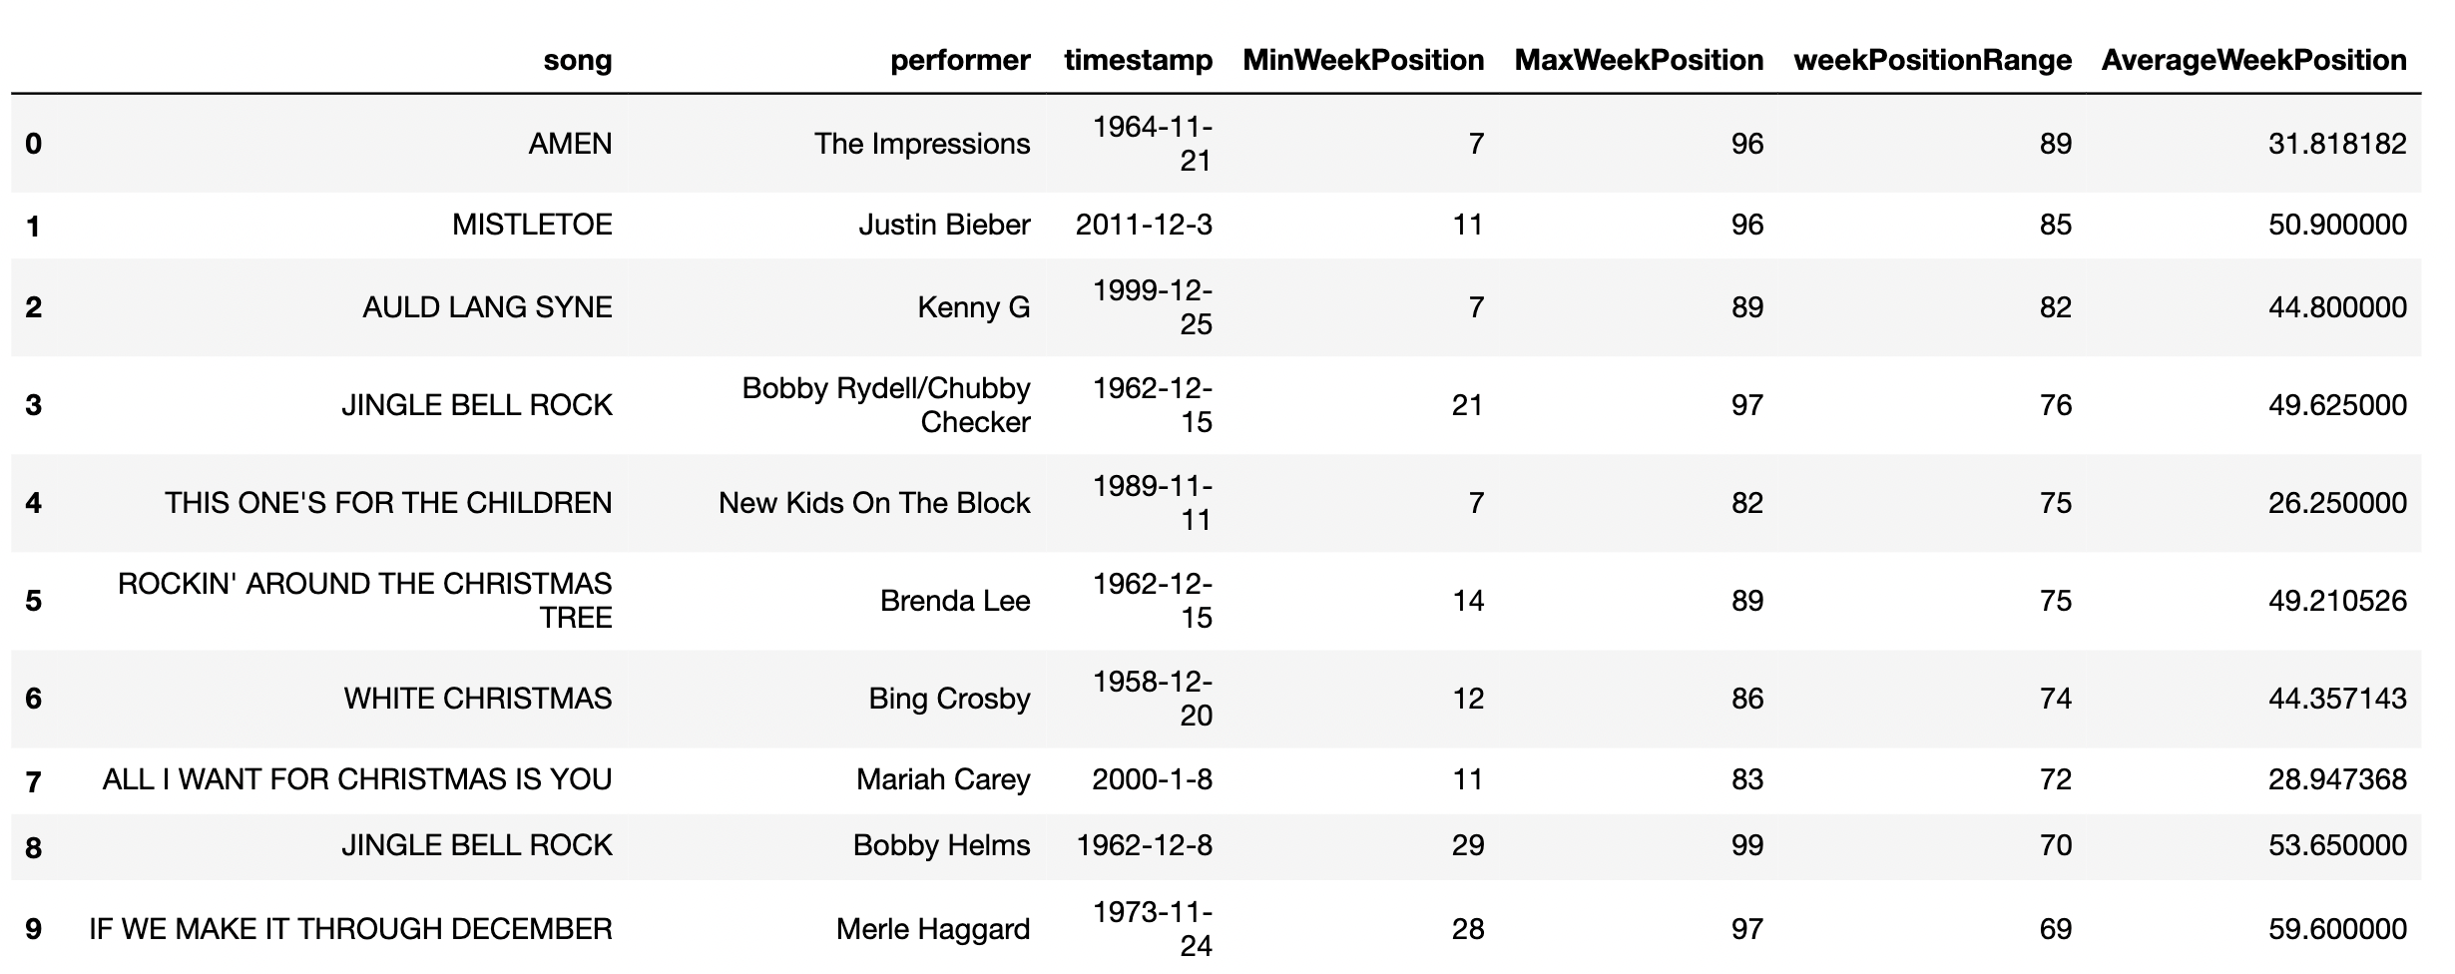
What can you tell me about week position?
Which are the 10 most successful songs? Assumption: success = largest interval from worst to best week-position
Findings: The 10 most successful songs…
were all over the time of investigation, with a slight bend towards the earlier being more successful
had their initial position in 90% before Christmas
were no worse with their best position than below 30
were in 70% performed by individuals, not groups.
The top 5 songs did not contain “Christmas” in their title

Slide 13
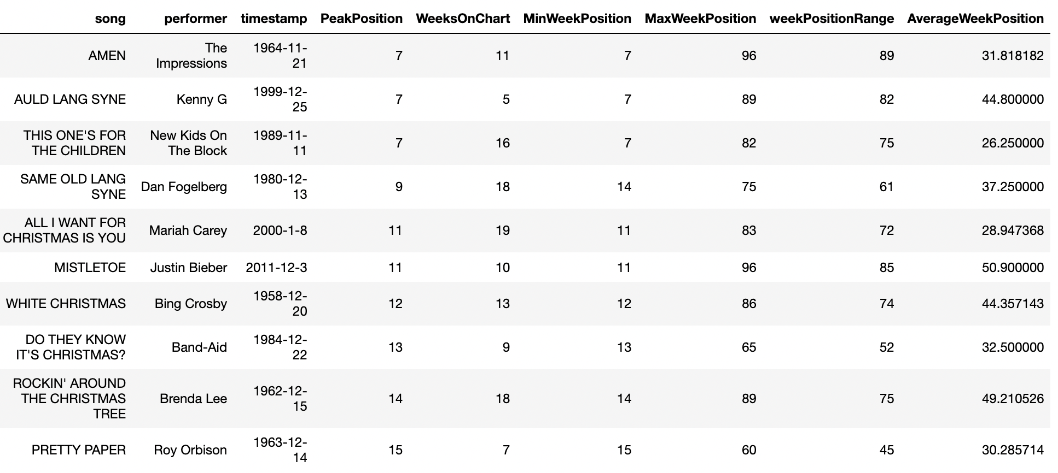
What can you tell me about week position?
Which are the 10 most successful songs? Assumption: success = best week-position ever during their presence in the charts
Findings: The 10 most successful songs…
were all over the time of investigation
had their initial position in 90% before or at Christmas
were at least during 5 weeks on the charts, in 70% at least 10 weeks
were performed in 80% by individuals, not groups.
Contained in 40% “Christmas” in their title

Slide 14
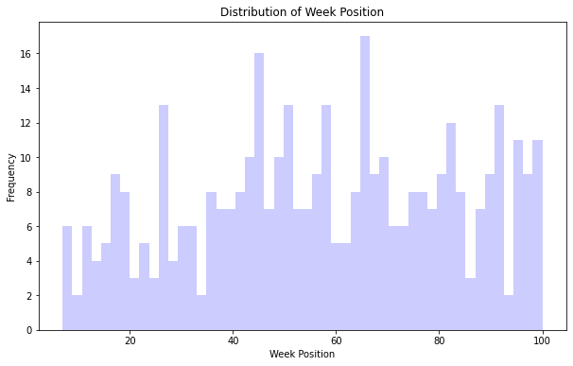
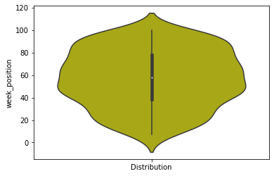
What can you tell me about week position?
Graphical statistical information on week position:

Slide 15
What can you tell me about week position?
There are 279 records out of 387 (∼72%) that indicate a change in chart’s position.
The remaining were single presences

Slide 16
What can you tell me about week position?
Is the change in ranking better before or after Christmas?
Change in rankings are in months November, December and January.
81 entries with better rankings before Christmas (40.5%)
119 entries with better rankings after Christmas (59.5%)

Slide 17
What can you tell me about week position?
Null Hypothesis H0 : The average week-position is independent of whether the week-position is before or after Christmas. i.e. the two group means of the groups – before and after Christmas – are the same.
Run a t-test: p-value = 3.648e-09
H0 is being rejected. The average week-position before Christmas differs significantly from the average week-position after Christmas!
Mean Week-Position before Xmas: 65.6 | Mean Week-Position after Xmas: 50.6

Slide 18
What can you tell me about week position?
Counting the numbers of datasets that have “Christmas” in their title:
234 (60.5%) without “Christmas”
153 (39.5%) with “Christmas”
Counting the numbers of unique songs that have “Christmas” in their title:
44 (56.4%) without “Christmas”
34 (43.6%) with “Christmas”

Slide 19
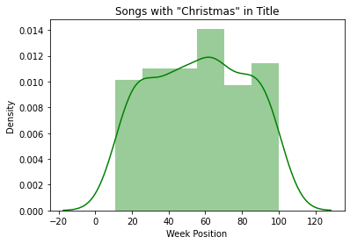
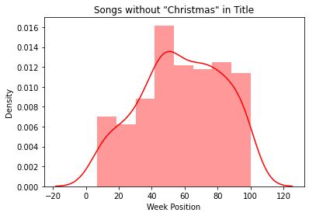
What can you tell me about week position?
Some graphic information on the split:

Slide 20
What can you tell me about week position?
Null Hypothesis H0 : The average week-position is independent of whether the song contains “Christmas” in its title.
Run a t-test: p-value = 0.570
H0 is being accepted. The average week-position of a song is not dependant on whether the songtitle contains "Christmas"

Slide 21
What can you tell me about week position?
Null Hypothesis H0 : Whether a song is performed by an individual or a group does not have an influence on the week-position in the chart.
Run a t-test: p-value = 0.961
H0 is being accepted. There is no indication that the performer has a signifcant influence on the week-position of a song in the chart.

Slide 22
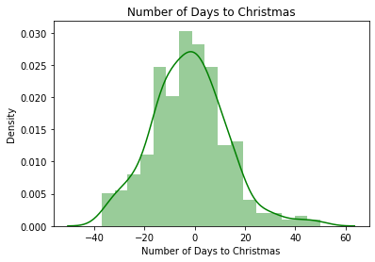
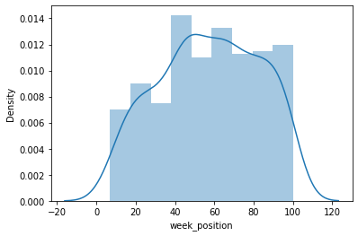
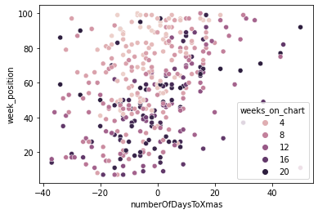
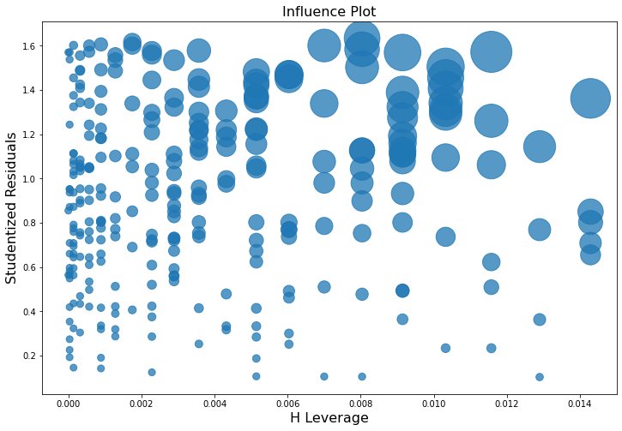
What can you tell me about week position?
Influence of Time to Christmas on Week Position: Does the closeness (timewise) to Christmas have an influence on week-position?
Null Hypothesis H0: The time-distance to Christmas has no significant influence on the week-position of a song in the charts.
→ With a p-value = 0.93 H0 is accepted! (Running a linear regression)

Slide 23
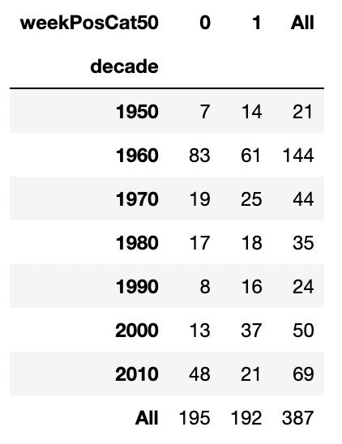
What can you tell me about week position?
Test if the good or bad week-position differs significantly during the decades. For this test the week-position needed to be recoded because there were too few data. The recoding was: 0 for a position below median (<58 as good) and 1 (>58 as bad) above.
Run an Independent Chi-Square Test
Null Hypothesis H0: The decade has no significant influence on the quality (good/bad) of week-position of a song.
With a p-value = 0.00507 H0 is rejected!
In other words: The decade has a significant influence on the quality of week position of a song!

Slide 24
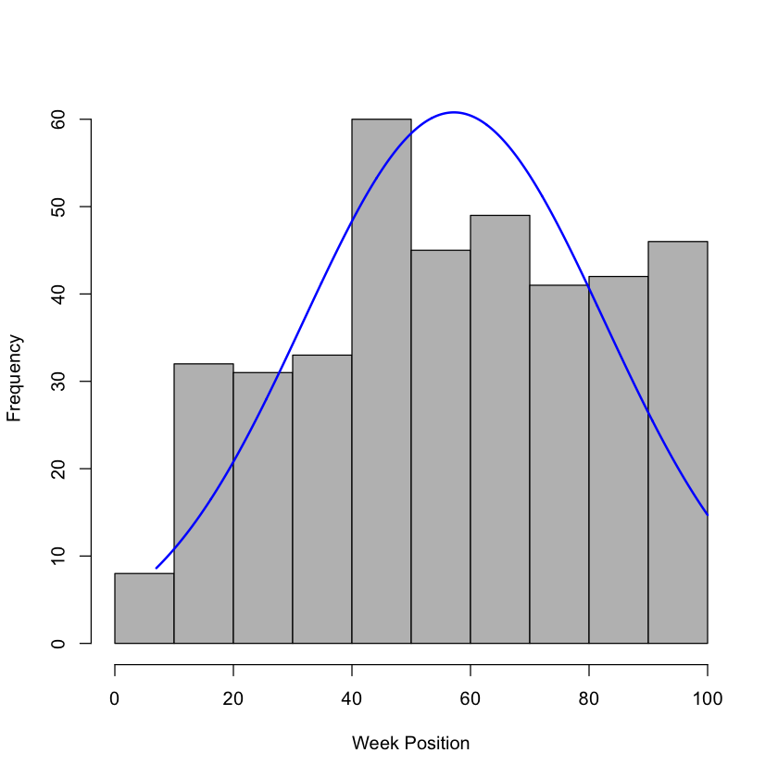
What can you tell me about week position?
Test if the week-position differs significantly during the decades.
Run a Repeated ANOVA Test in R:
Null Hypothesis H0: The decade of a songs appearance in the chart has no significant influence on the week-position of a song.
With a p-value = 0.011 H0 is rejected!
In other words: The decade has a significant influence on the week position of a song in the charts! This result confirms the finding and result of the Chi Square test conducted before.

Slide 25
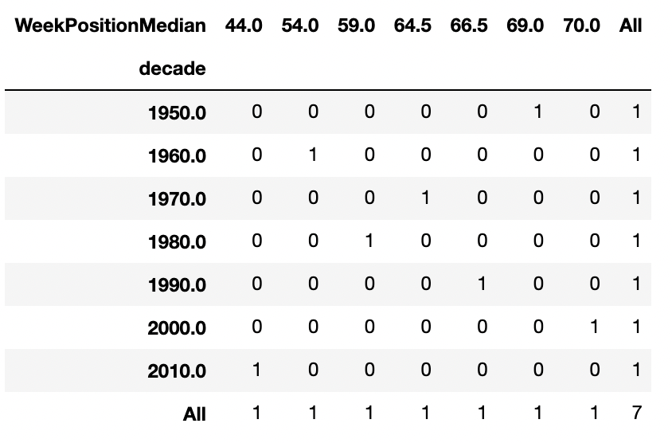
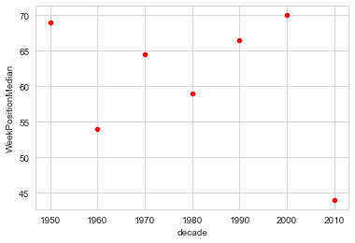
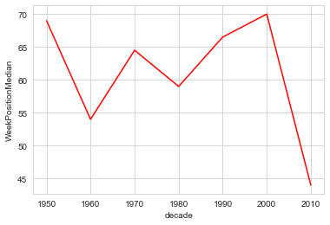
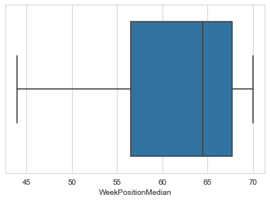
What can you tell me about week position?
Crosstable and visual investigation of the median week position per decade.
Correlation = -0.337
Interestingly the median drops significantly for the decade 2010!

Slide 26
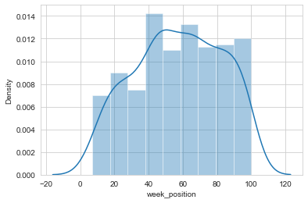
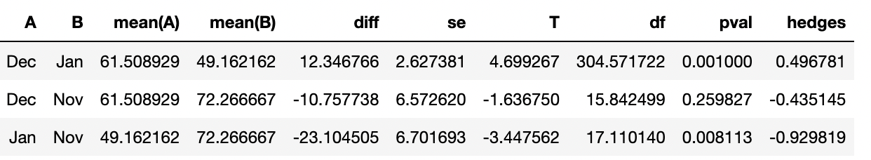
What can you tell me about week position?
Test if the month of rank has a significant influence on the week-position
Run an ANOVA Test:
Null Hypothesis H0: The month has no significant influence on the week-position of a song in the charts.
With a p-value = 0.000034 H0 is rejected!
The month has a significant influence on the week position of a song in the charts! A Welch’s ANOVA test revealed that the mean difference between:
December and January
November and January
are significantly different, with the best average position in January, followed by December and November.

Slide 27
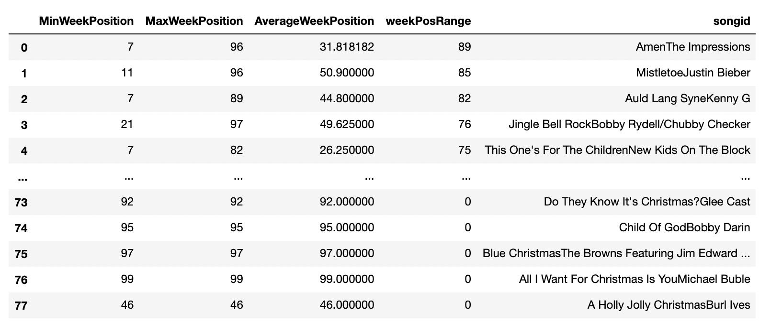
What can you tell me about week position?

Slide 28
What can you tell me about weeks on the chart?
General statistical information on Weeks on Chart (WoC) globally:
Count: 387.000000
Mean: 9.645995
Stand Dev: 6.142627
Min: 1.000000 = shortest time of presence in chart
25%: 5.000000
50%: 8.000000 = median time of presence in chart
75%: 15.000000
Max: 20.000000 = longest time of presence in chart

Slide 29
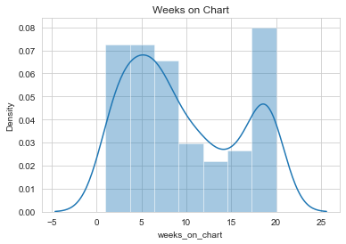
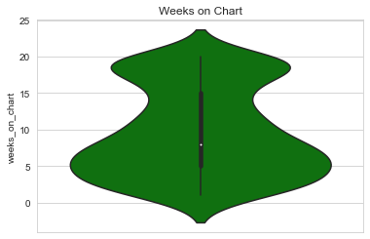
What can you tell me about weeks on the chart?
General statistical information on Weeks on Chart (WoC) globally:

Slide 30
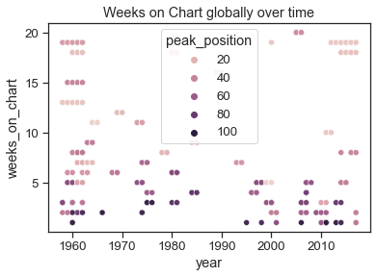
What can you tell me about weeks on the chart?
General statistical information on Weeks on Chart (WoC) globally:

Slide 31
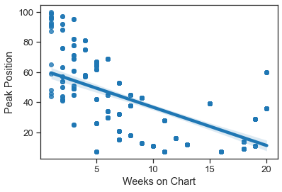
What can you tell me about weeks on the chart?
General statistical information on Weeks on Chart (WoC) globally:
The longer a song is on the chart, the better its position (i.e. the lower the number of the peak position) → negative correlation which is to be expected

Slide 32
What can you tell me about weeks on the chart?
General statistical information on Weeks on Chart (WoC) per Season:
Count: 106.000000
Mean: 3.650943
Stand Dev: 2.665628
Min: 1.000000 = shortest time of presence in chart
25%: 1.250000
50%: 3.000000 = median time of presence in chart
75%: 5.000000
Max: 13.000000 = longest time of presence in chart

Slide 33
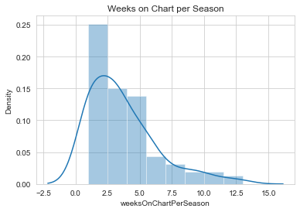
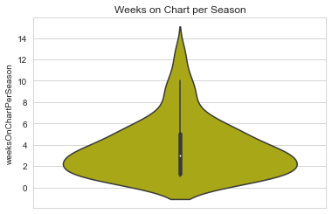
What can you tell me about weeks on the chart?
General statistical information on Weeks on Chart (WoC) Per Season:

Slide 34
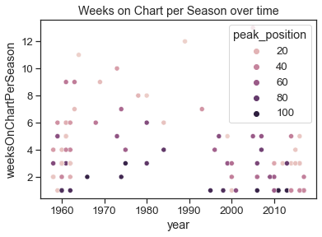
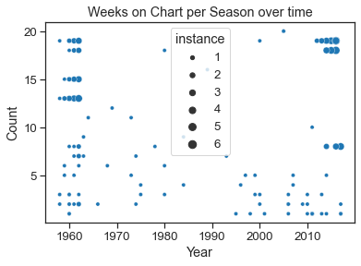
What can you tell me about weeks on the chart?
General statistical information on Weeks on Chart (WoC) per Season:

Slide 35
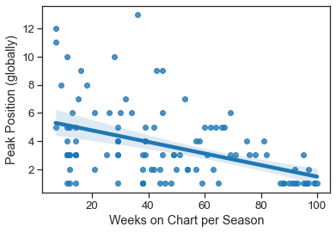
What can you tell me about weeks on the chart?
General statistical information on Weeks on Chart (WoC) per Season:
The longer a song is on the chart per season, the better its position (i.e. the lower the number of the peak position) → negative correlation which is to be expected, although not as strong as globally

Slide 36
What can you tell me about weeks on the chart?
Null Hypothesis H0 : There is no signifcant difference in the means of the songs performed by a group or an individual.
.
With a p-value = 0.195 H0 is accepted!

Slide 37
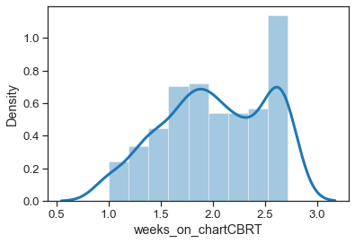
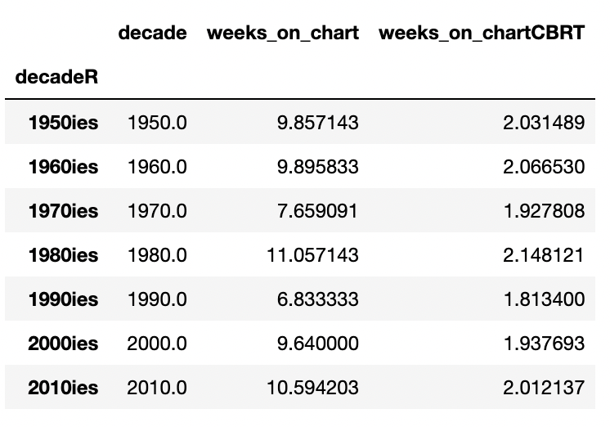
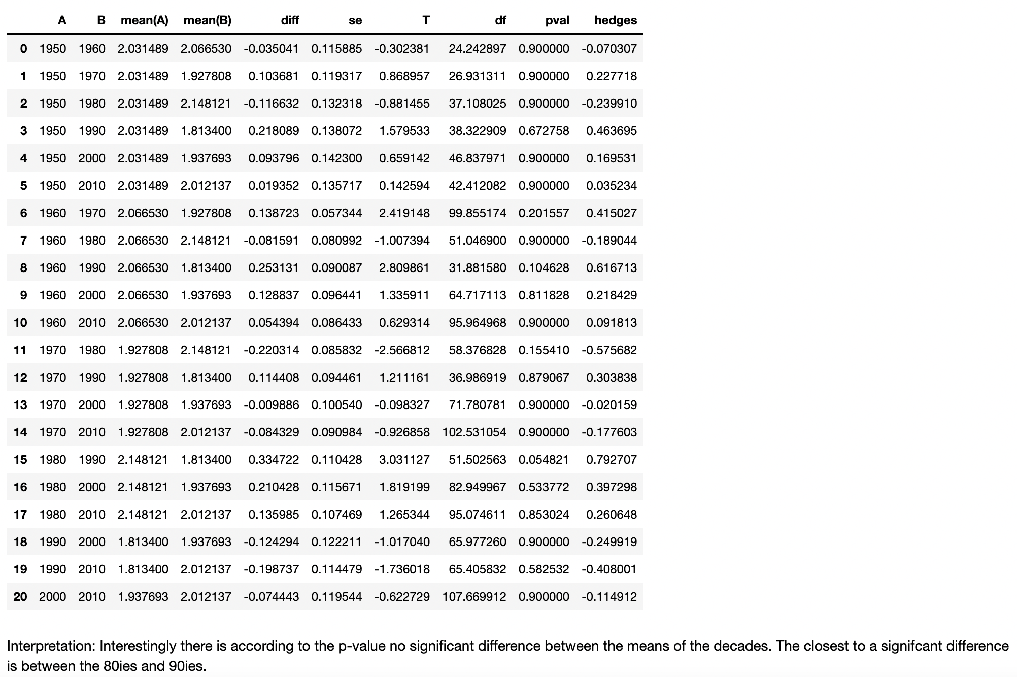
What can you tell me about weeks on the chart?
Null Hypothesis H0 : There is no siginifcant influence of decade of the Song position on the weeks of presence in the Chart.
With a p-value = 0.0243 H0 is rejected!
According to Welch’s ANOVA:
Interestingly there is according to the p-value no significant difference between the means of the decades. The closest to a significant difference is between the 80ies and 90ies.

Slide 38
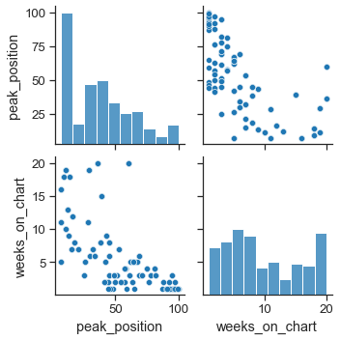
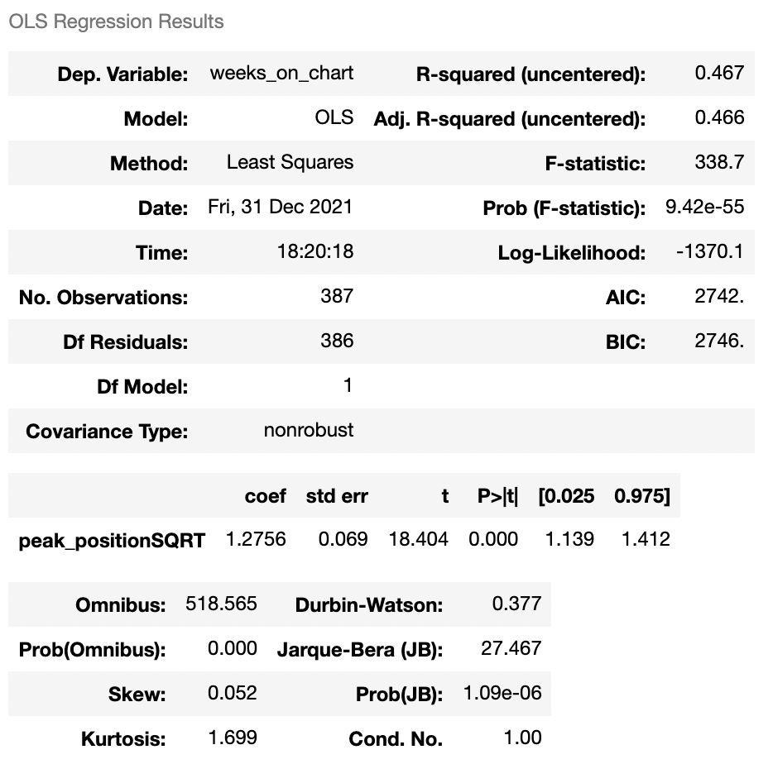
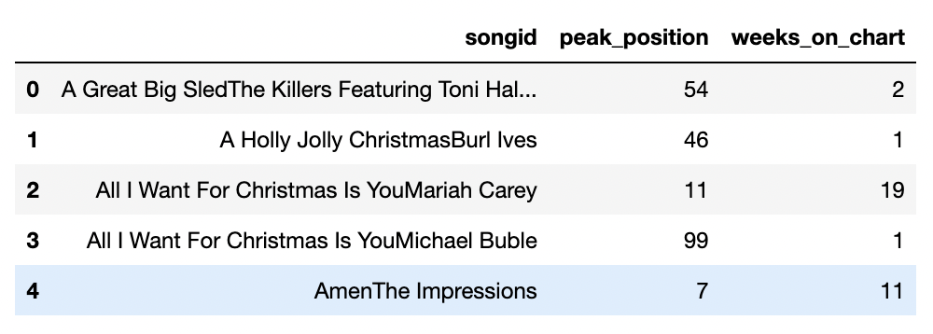
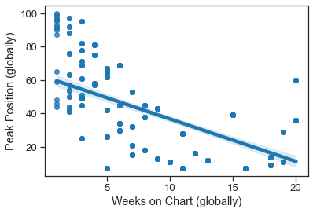
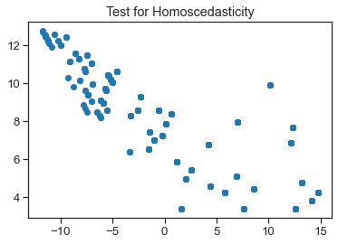
What can you tell me about weeks on the chart?
Null Hypothesis H0 : There is no signifcant influence of peak-position of the Song on the weeks of presence in the Chart.
With a p-value = 9.42e-55 H0 is rejected!

Slide 39
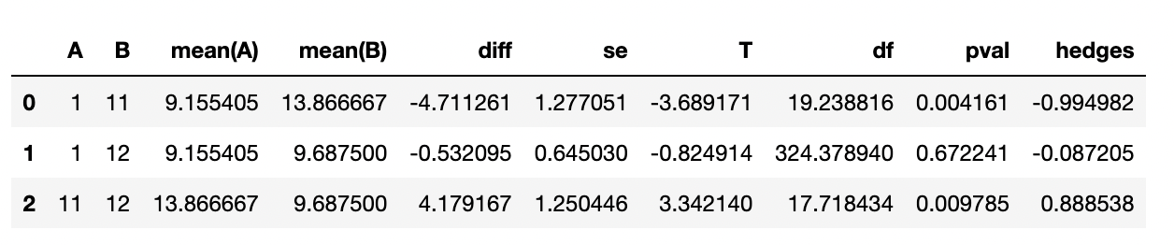
What can you tell me about weeks on the chart?
Null Hypothesis H0 : There is no signifcant influence of the month of first appearance on the chart of the Song on the weeks of presence in the Chart.
With a p-value = 0.003H0 is rejected!
The p-values in the table to the right show:
The mean difference between
January and November and
November and December
are significantly different.
Also: the average duration of presence on the chart is longest if the song first appeared in November, then in December and finally in January - which was to be expected. Although the difference between December and January is minimal.

Slide 40
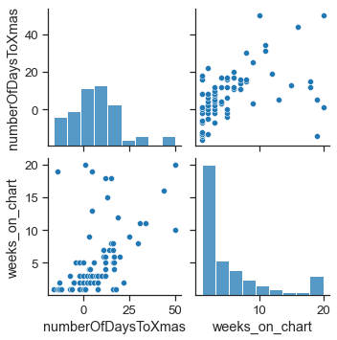
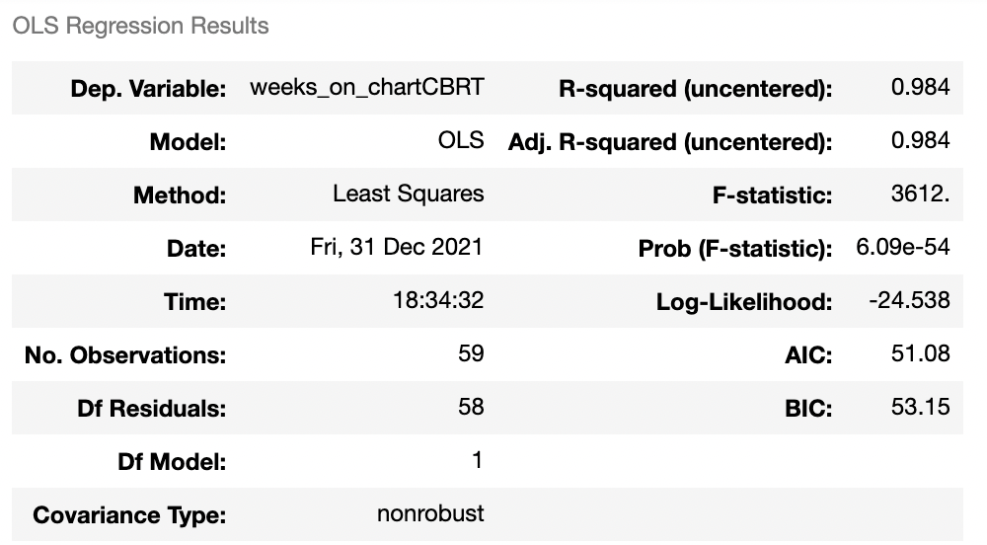
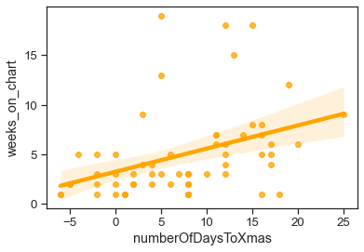
What can you tell me about weeks on the chart?
Null Hypothesis H0 : There is no signifcant influence of of time-to-christmas of first appearance of the Song on the weeks of presence in the Chart.
With a p-value = 6.09e-54H0 is rejected!
The number of days to (or from) Christmas explain 98.4% (!) of the variability in number of weeks on chart (R-squared value).
The number of days to (or from) Christmas significantly influence the number of weeks on chart.

Slide 41
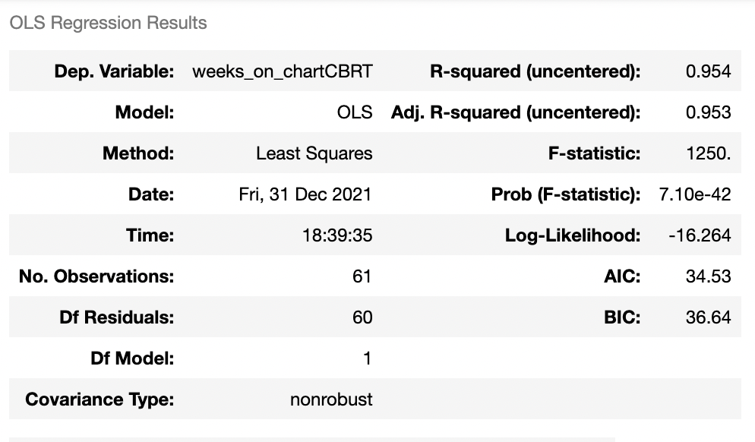
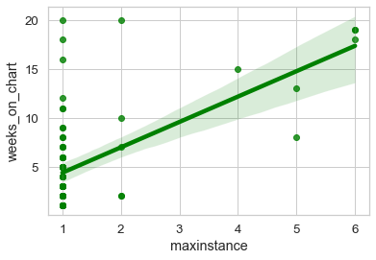
What can you tell me about weeks on the chart?
Null Hypothesis H0 : There is no significant influence of instances of a Song on the weeks of presence in the Chart.
With a p-value = 7.10e-42 H0 is rejected!
The (max) number of instances explains 95.4% of the variability in number of weeks on chart (R-squared value).
The (max) number of instances significantly influence the number of weeks on chart.

Slide 42
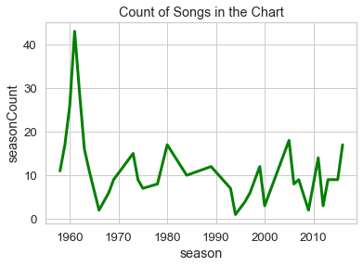
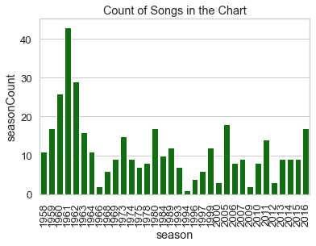
What can you tell me about weeks on the chart?
Some statistics on song counts per season

Slide 43
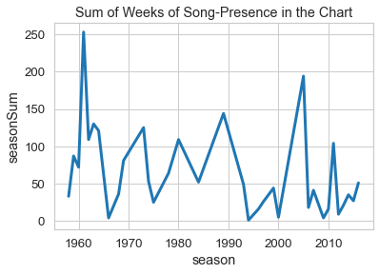
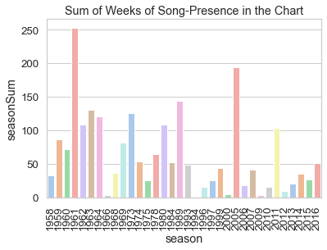
What can you tell me about weeks on the chart?
Some statistics on song presence

Slide 44
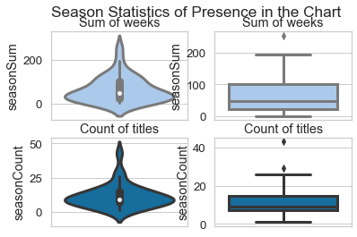
What can you tell me about weeks on the chart?
Some statistics on song presence

Slide 45

What can you tell me about weeks on the chart?
Some basic statistics related to decades:
It seems like Christmas-Songs were the most popular in the 1960ies while the least in 1990ies with an increasing trend in the last decade (only in terms of number of songs but not of presence in the chart!).

Slide 46
What can you tell me about weeks on the chart?
Machine Learning Model to predict the duration on chart
Run a machine learning model to investigate whether it is appropriate to predict weeks on chart per season and check which factor has how much influence. Because there are 13 different classes of week-duration (1-13) and too few datasets reclassify the duration as:
presence of 1 week only
presence of 1 month (2-4 weeks)
presence of more than a month (5 weeks or more)

Slide 47

What can you tell me about weeks on the chart?
Machine Learning Model to predict the duration on chart
Interpretation:
The model is 81% accurate (weighted avg)
There is 100% accuracy for songs that are only 1 week present in the charts; for 2-4 weeks 72% and for more 83%
5 songs were correctly predicted as 1-week-presence-songs, 7 were erroneously classified as 2-4-week-presence-songs and 2 erroneously as more-than-a-month-songs
38 songs were correctly predicted as 2-4-week-presence-songs, 0 were erroneously classified as 1-week-presence-songs and 10 erroneously as more-than-a-month-songs
58 songs were correctly predicted as more-than-a-month-songs, 0 were erroneously classified as 1-week-presence-songs and 8 erroneously as 2-4-week-presence-songs

Slide 48

What can you tell me about weeks on the chart?
Machine Learning Model to predict the duration on chart
Hyperparameter Tuning – Although many different parameter changes were tried, the model could not be improved.

Slide 49


What can you tell me about weeks on the chart?
Machine Learning Model to predict the duration on chart
Feature importance
Interpretation:
season seems to be the most influential variable with nearly 20%
week position, year and number of Days to Christmas are also influential with each more than 10%
the remaining 8 variables are between nearly 2% and 9%
whether the song first appeared before or after Christmas seems to have the least impact

Slide 50
Some more information on the data…
Counting the numbers of datasets that have “Christmas” in their title:
234 (60.5%) without “Christmas”
153 (39.5%) with “Christmas”
Counting the numbers of unique songs that have “Christmas” in their title:
44 (56.4%) without “Christmas”
34 (43.6%) with “Christmas”

Slide 51
Some more information on the data…
Some graphic information on the split:

Slide 52

Some more information on the data…
Some graphic information on the split: Distribution of the records / songs:

Slide 53
Some more information/visuals on the data…
The following charts and graphs were created with
Orange (Source: https://orangedatamining.com/)

Slide 54

Some more information/visuals on the data…
The graph shows on the x-axis the week-position (best to the left, worst to the right) split by the performer group:
Blue = Individual performer
Red = Group performer
It shows that percentage-wise groups performed better than individuals!

Slide 55

Some more information/visuals on the data…
The graph shows on the x-axis the weeks on the chart split by the performer group (percentages):
Blue = Individual performer
Red = Group performer
It shows a very heterogenous distribution with some tendency that groups were longer on the chart.

Slide 56

Some more information/visuals on the data…
The graph shows on the x-axis instances of a song split by the performer group (percentages):
Blue = Individual performer
Red = Group performer
It shows that while one time occurrences are nearly equally split between groups and individuals, repeated appearance was a domain of individuals.

Slide 57

Some more information/visuals on the data…
The graph shows on the x-axis the season, on the y-axis the weeks on charts per season and in colour the number of days to/from Christmas.
In the 60ies there was hardly any presence after Christmas while later, especially in the 70ies and post 90ies there were songs present after Christmas. The longer a song was on the chart (higher y-value) the longer before Christmas it was on the chart initially!

Slide 58

Some more information/visuals on the data…
The graph shows on the x-axis week-position, on the y-axis the position-change per week and in colour the decade.
There is one song in 2000 that made the biggest leap from position 54 to position 7 (yellow dot in the lower left corner). It looks like in more recent years the position changes were bigger than earlier but also the positions were worse (upper right).

Slide 59

Some more information/visuals on the data…
The graph shows on the x-axis weeks on the chart, on the y-axis the peak-position and in colour the decade.
Less successful songs (top left) are more recent than in decades before. Typical “negative” correlation: the higher the position (=less successful) the shorter the presence in the chart.

Slide 60

Some more information/visuals on the data…
BoxPlot: The graph shows weeks on the chart split by week’s position better or worse than position 58 (overall median).
It shows clearly that better positioned songs (lower blue bar) were longer on the chart than worse positioned songs (upper blue bar)

Slide 61

Some more information/visuals on the data…
BoxPlot: The graph shows weeks position whether before (upper bar) or after (lower bar) Christmas.
It shows that if songs were positioned before Christmas their position is better.

Slide 62


Some more information/visuals on the data…
Correlations of week position and weeks on chart to other variables:

